Slide 1
People and Processes for data management and analytics
Cathy O’Neil, Lead Data Scientist

Slide 2
When do you need a data scientist?

Slide 3
When you have too much data for Excel to handle
When do you need a data scientist?

Slide 4
When your data visualization skills are being stretched
When do you need a data scientist?

Slide 5
When you aren’t sure if something is noise or information
When do you need a data scientist?

Slide 6
When you don’t know what a confidence interval is
When do you need a data scientist?

Slide 7
Let’s take a step back:
Should you need a data scientist?

Slide 8
Are you asking the right questions?
Should you need a data scientist?

Slide 9
Are you getting the most out of your data?
Should you need a data scientist?

Slide 10
Are you anticipating shocks to your business?
Should you need a data scientist?

Slide 11
Are you running your business sufficiently quantitatively?
Should you need a data scientist?

Slide 12
So, you’ve decided to hire a Data Scientist (nice move!)

Slide 13
What do you need to get started?

Slide 14
Data storage
What do you need to get started?

Slide 15
Data access — usually through a database (payoffs for different types)
What do you need to get started?

Slide 16
Larger-scale or less uniform data may require Hadoop access (and someone with real tech expertise to set it up)
What do you need to get started?

Slide 17
Who and how should you hire?

Slide 18
A math major? Perhaps a Masters in statistics? Or a Ph.D. in machine learning?
Who and how should you hire?

Slide 19
What should the job description include?
Who and how should you hire?

Slide 20
Who even interviews someone like this?
Who and how should you hire?

Slide 21
What does a Data Scientist want from you?

Slide 22
Interesting, challenging work
What do they want from you?

Slide 23
Lots of great data (data is sexy!)
What do they want from you?

Slide 24
To be needed, and to have central importance to the business
What do they want from you?

Slide 25
To be part of a team that is building something
What do they want from you?

Slide 26
A good and ethically sound work atmosphere
What do they want from you?

Slide 27
Cash money
What do they want from you?

Slide 28
Further business reasons for hiring a Data Scientist

Slide 29
Reporting help
Further business reasons

Slide 30
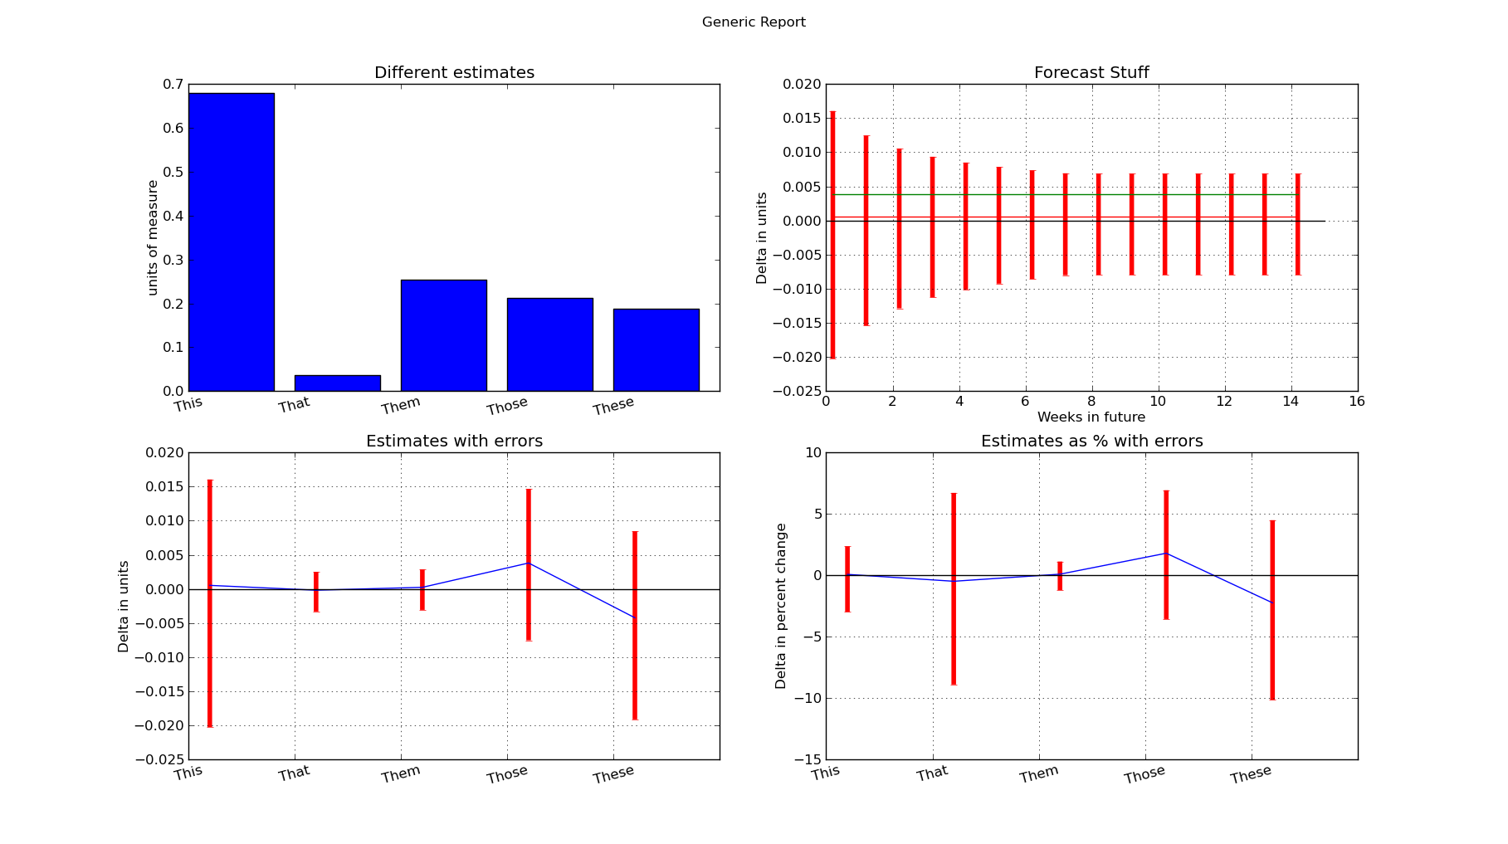
Reporting help

Slide 31
Enables you to see into data without taxing your tech team (beyond setup)
Further business reasons

Slide 32
A/B testing
Further business reasons

Slide 33
Beyond A/B testing: adaptability and customization
Further business reasons

Slide 34
Knowing whether numbers are random (seasonality) or require action
Further business reasons

Slide 35
What-if analysis
Further business reasons

Slide 36
Help with business planning:
Will there be enough data to answer a given question?
Will there be enough data to optimize on the answer?
Further business reasons

Slide 37
Education for senior management
Further business reasons

Slide 38
Mathematically sound communication to clients
Further business reasons

Slide 39
Case Study: Stress Tests

Slide 40
We can learn from finance — data miners are spoiled for data
Case Study: Stress Tests

Slide 41
You know how big changes will affect your business directionally and specifically
Case Study: Stress Tests

Slide 42
Stress tests allow you to combine changes and estimate quantitatively
Case Study: Stress Tests

Slide 43
